Slide 1
Learning from Noisy Labels
Xiaoyu Li
2020.12.11

Slide 2
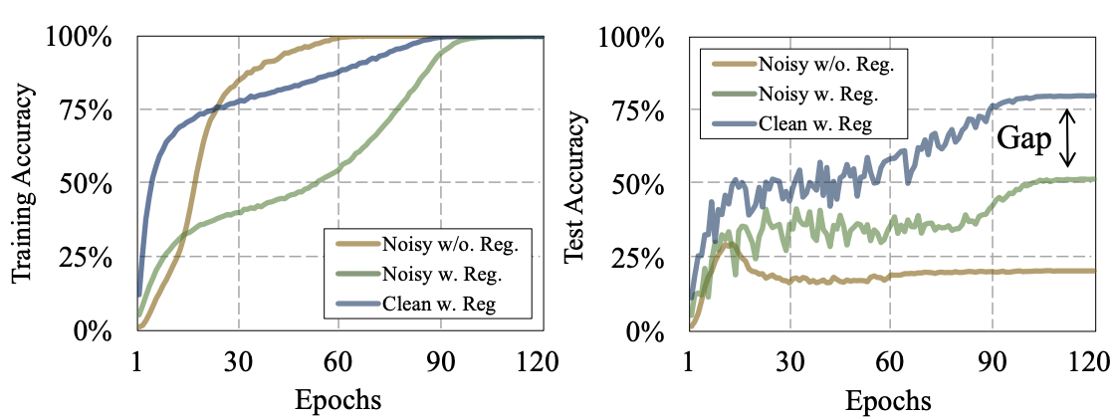
Background
Impressive DNNs’ success in CV, IR, NLP is dependent on the availability of massive but carefully labeled data, which are expensive and time-consuming to obtain.
The ratio of corrupted labels in real-world datasets is reported to range from 8.0% to 38.5%.
DNNs can easily fit an entire training dataset with any ratio of corrupted labels. Popular regularization techniques do not completely overcome the overfitting issue.(Data aug, weight decay, drop out BN)

Slide 3
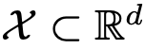
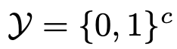
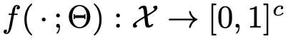
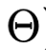
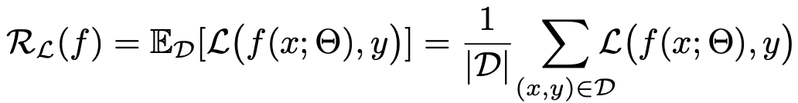
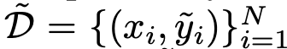
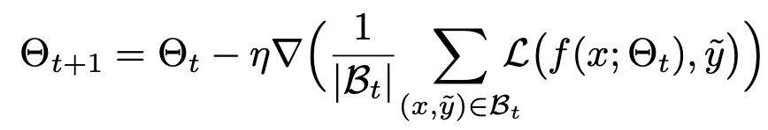
Problem formulation
from
To learn the mapping function:
To optimize with the empirical risk:
Now, some labels are corrupted
Then，risk minimization process becomes
Thus, function f can memorize samples with corrupted label.

Slide 4
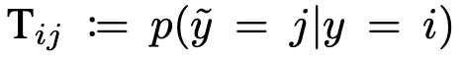
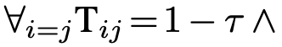
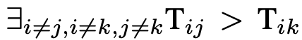
Problem formulation - label noise
Label transition matrix T
is the probability of the true label i being flipped into a corrupted label j
Noise ratio τ ∈ [0, 1]
Symmetric noise：
Asymmetric noise：
Stricter case：pair noise
Instance- and label- dependent noise

Slide 5
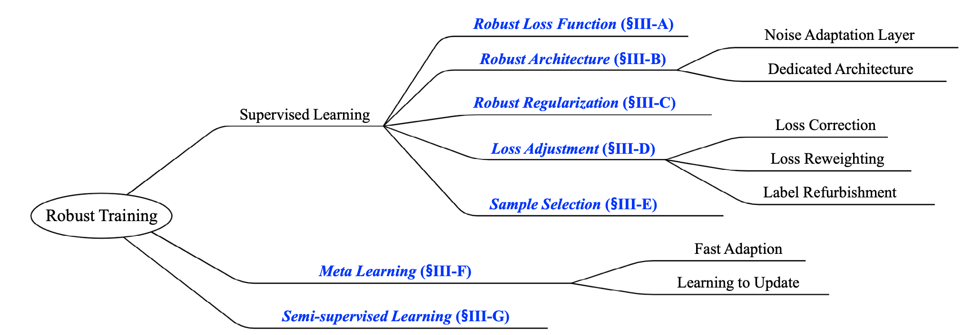
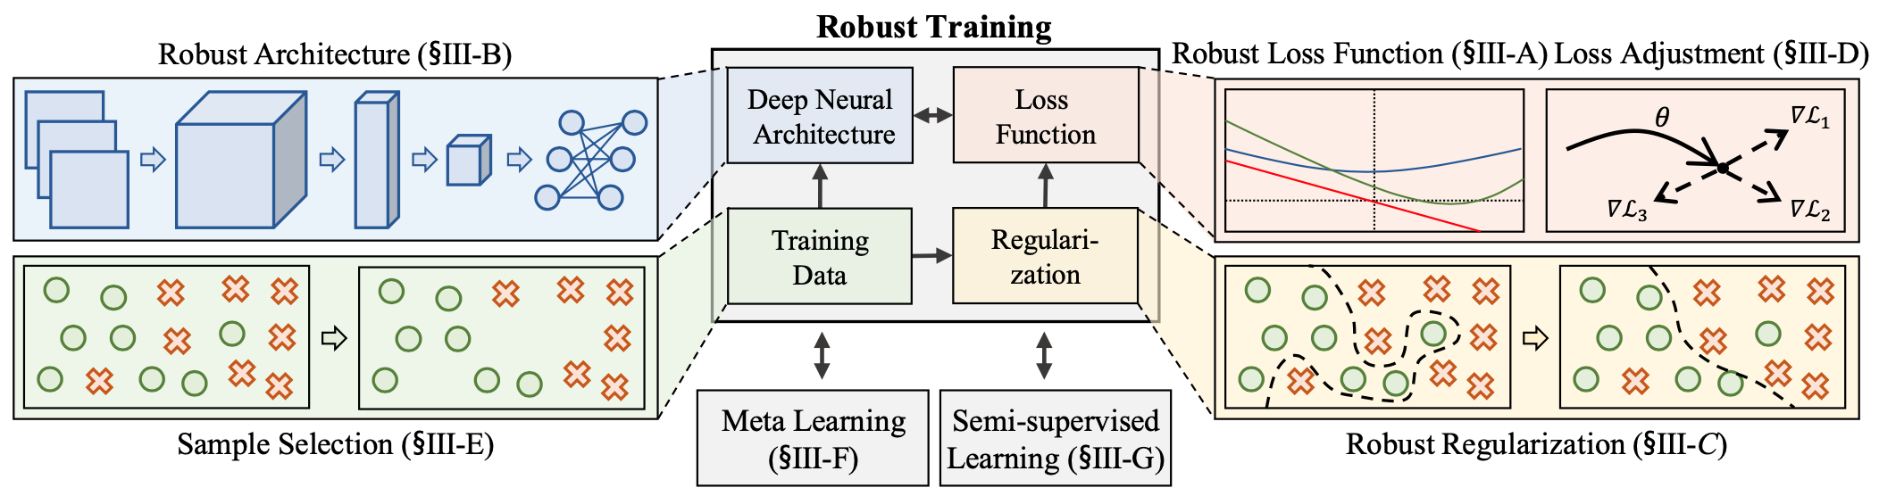
Overview

Slide 6
Overview
Robust loss function and loss adjustment
to modify the loss function or its value
Robust architecture
to change an architecture to model a noise transition matrix of a noisy dataset
Robust regularization
to enforce a DNN to overfit less to false-labeled samples
Sample selection
to identify true-labeled samples from noisy training data
Meta learning
Semi- supervised learning

Slide 7
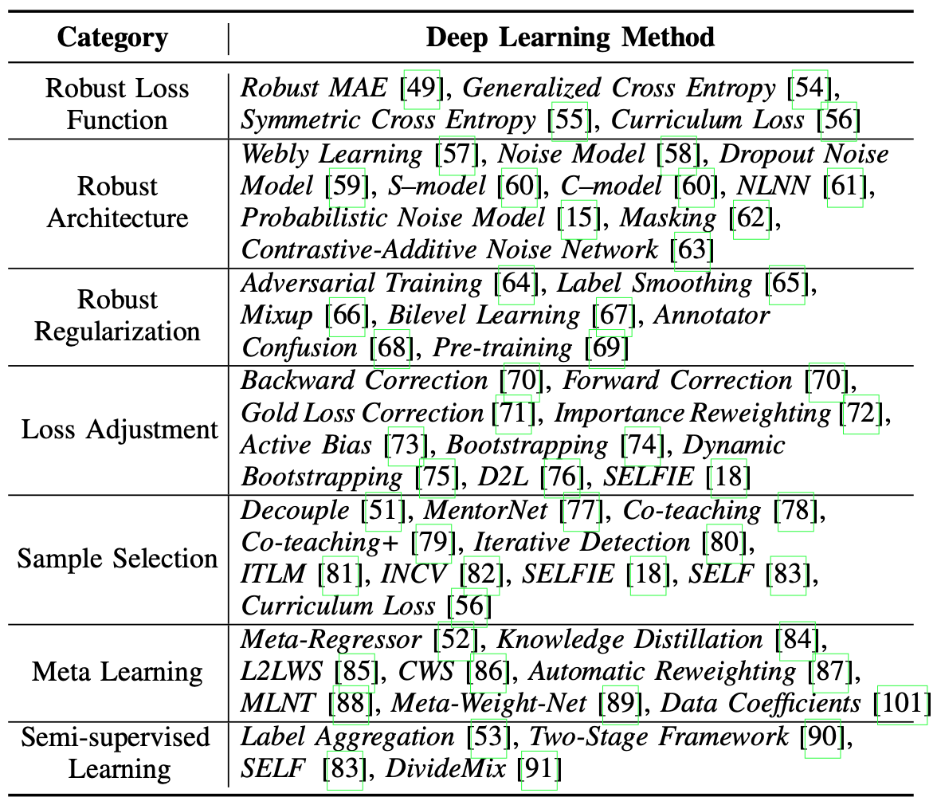
Early-learning Regularization
Detecting from Loss Curves
Meta Label Correction
Decoupling Representation and Classifier

Slide 8
Robust Loss Function
To provide a loss function that achieves a small risk for unseen clean data even when noisy labels exist in the training data
mean absolute error (MAE) loss. best generalization with simple data
generalized cross entropy (GCE). take advantage of MAE and CE
symmetric cross entropy(SCE). Add reversed CE
curriculum loss(CL). surrogate loss of the 0-1 loss function
Performances with such losses are significantly affected by noisy labels. Not robust for severe label noise.

Slide 9
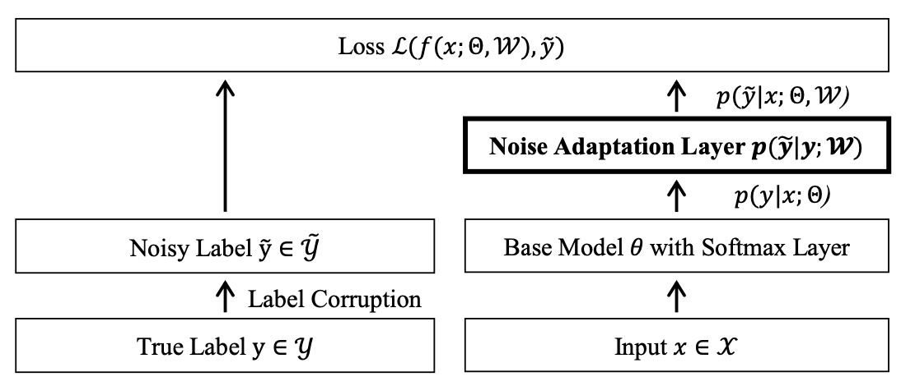
Robust Architecture
To model the label transition matrix
Noise adaptation layer
Add dropout
EM
Human-assist
…
Challenge to estimate the transition matrix

Slide 10
Robust Regularization
widely-used regularization techniques
Data augmentation, mixup
Label smoothing
Pretraining
Early-learning Reg
…
Flexible; Insignificant improvement; Additional hyperparameters

Slide 11
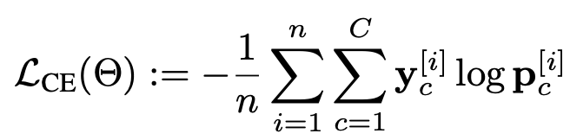
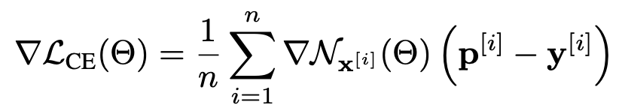
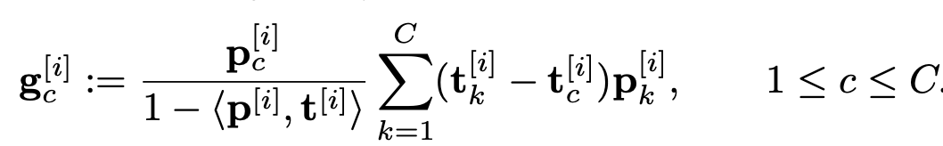
Early-Learning Regularization Prevents Memorization of Noisy Labels

Slide 12
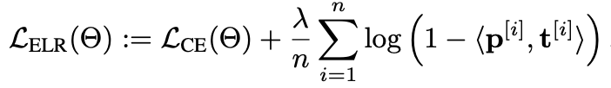
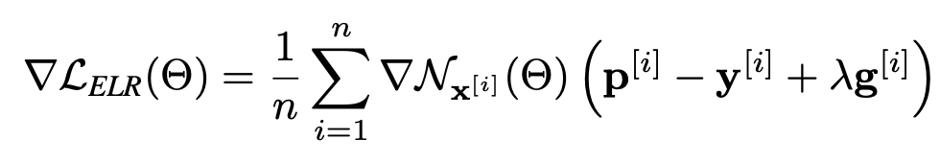
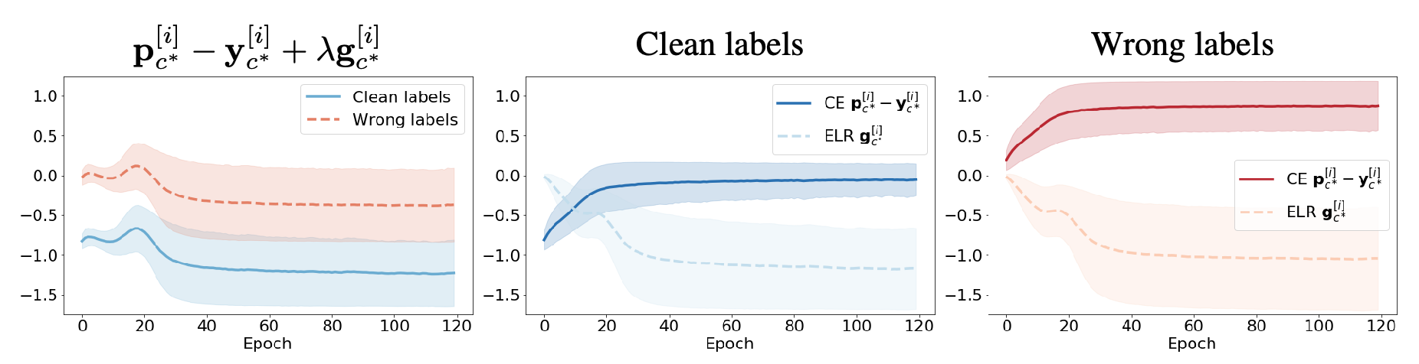
Early-Learning Regularization Prevents Memorization of Noisy Labels

Slide 13
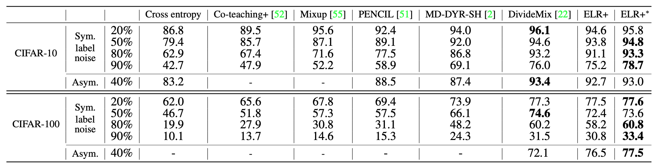
Early-Learning Regularization Prevents Memorization of Noisy Labels

Slide 14
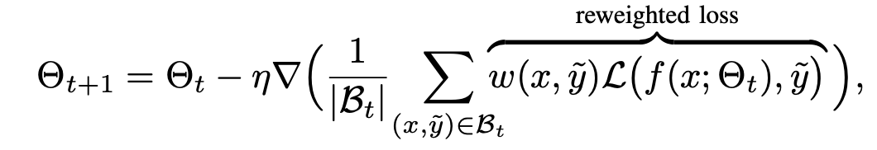
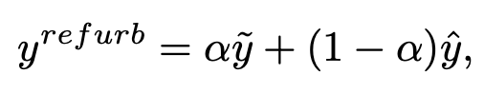
Loss Adjustment
Loss correction (base on transition matrix estimation)
Loss reweighting (weight sample by certain indicator, e.g. prediction variance)
Label refurbishment (convex combination of noisy and predicted labels)
label confidence α obtained via cross-validation; dynamically adjusts the confidence; consider consistent label prediction

Slide 15
Sample Selection
Selecting true-labeled samples from a noisy training dataset
Key: selection criteria
small-loss trick
memorization effect: DNNs are prone to learn clean samples first and then gradually learn other noisy samples
MentorNet, Co-teaching, INCV
Outlier Detection (e.g. density-based local outlier detection)
Combine with other methods

Slide 16
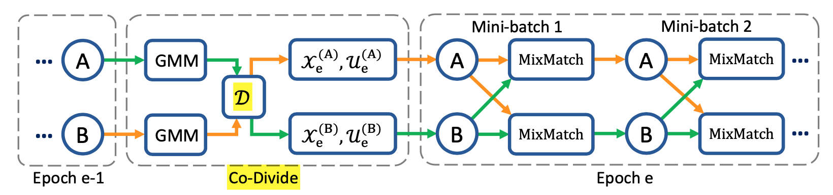
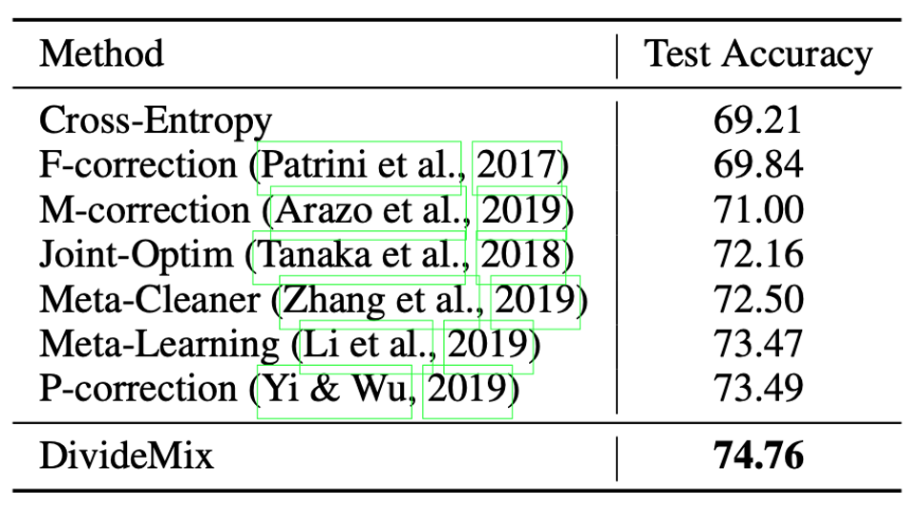
DivideMix

Slide 17
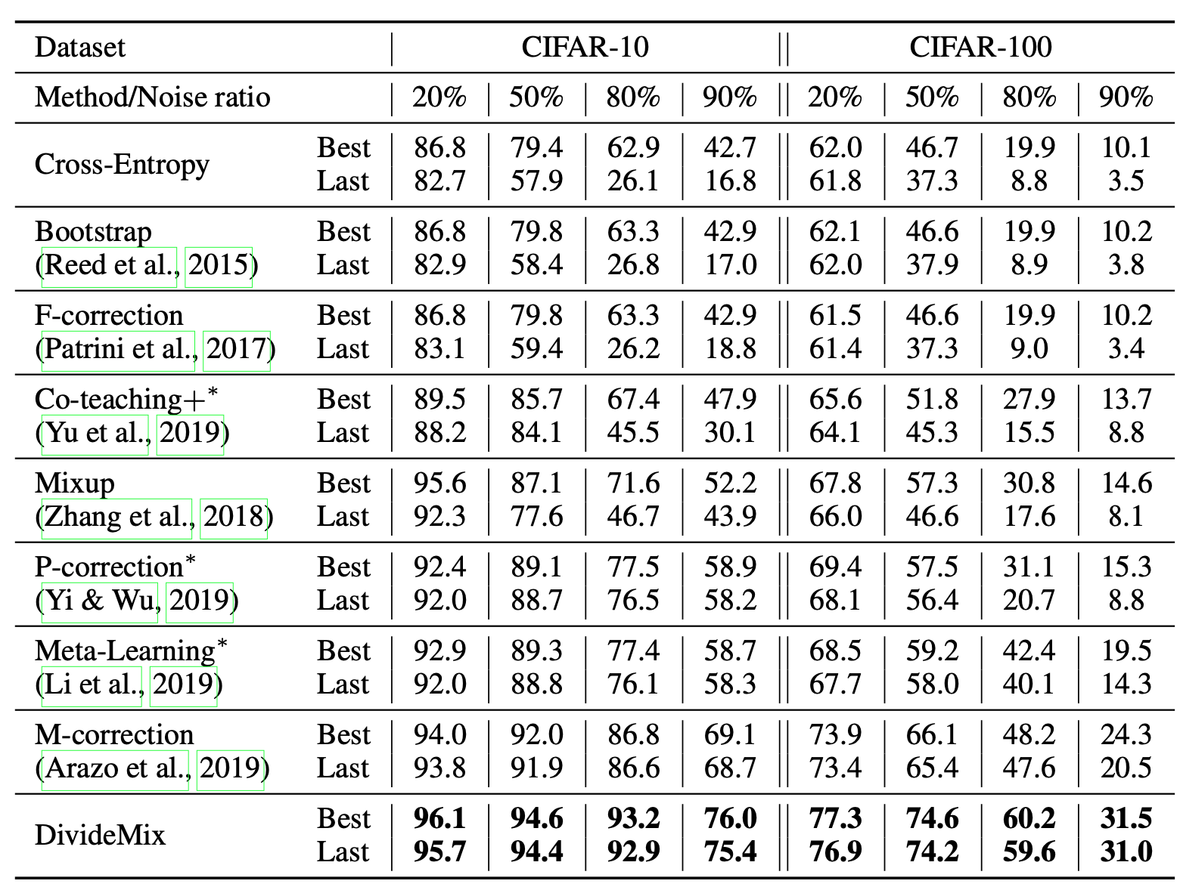
DivideMix

Slide 18
Meta Learning
MLNT (learn from synthetically corrupted labels)
L2LWS and CWS (train meta net on clean data)
L2RW (learn to weight based on gradient direction)
Meta-Weight-Net (learn the mapping from loss to weight)
Learning Adaptive Loss (learn the sensitive hyper-params of loss)
Data Coefficient (meta-reweighting + refurbish)
Meta Soft Label Corrector
Meta-label-correction

Slide 19
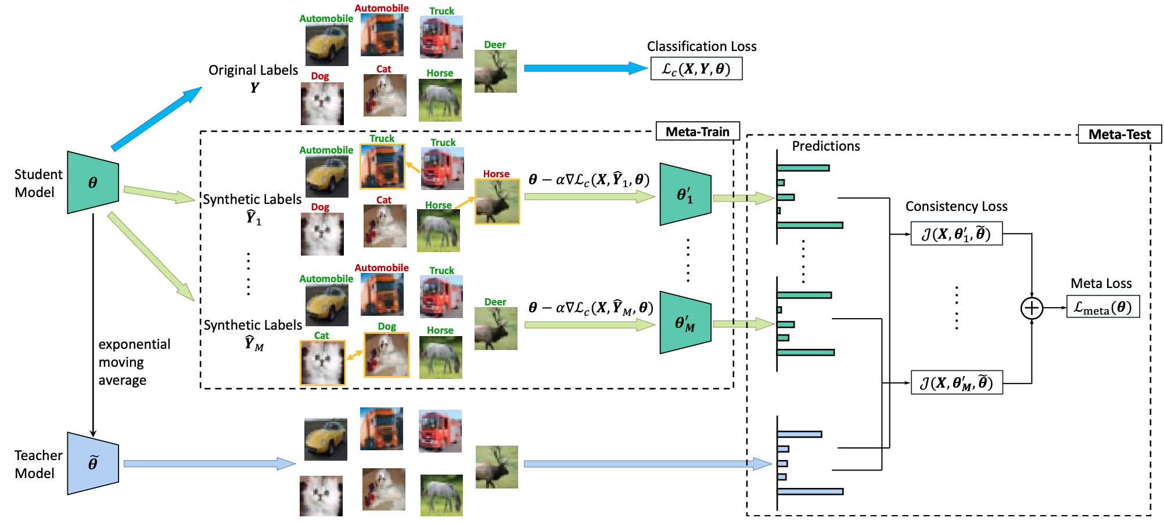
MLNT

Slide 20
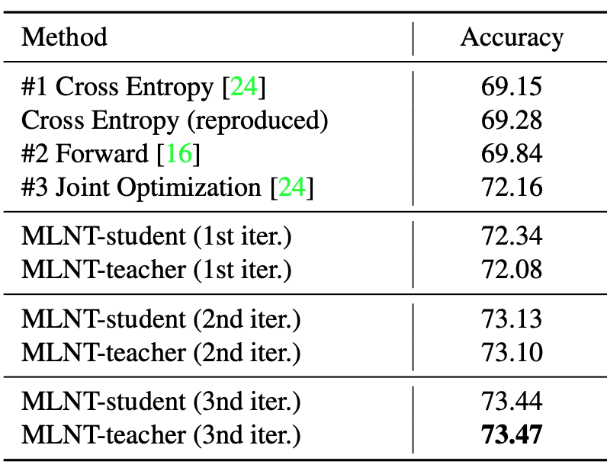
MLNT

Slide 21
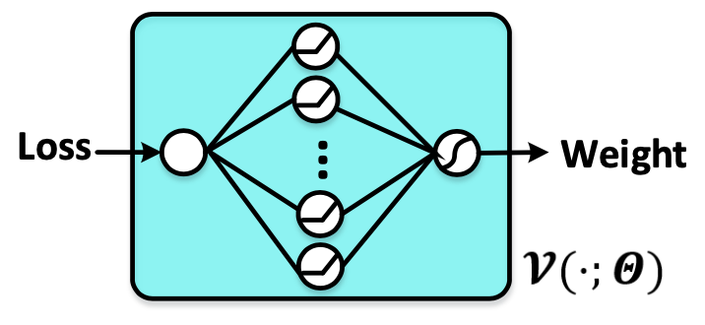
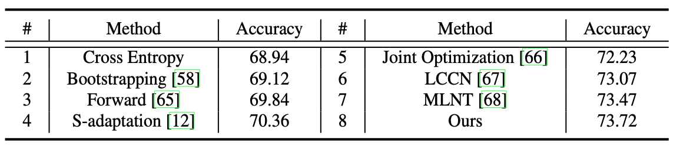
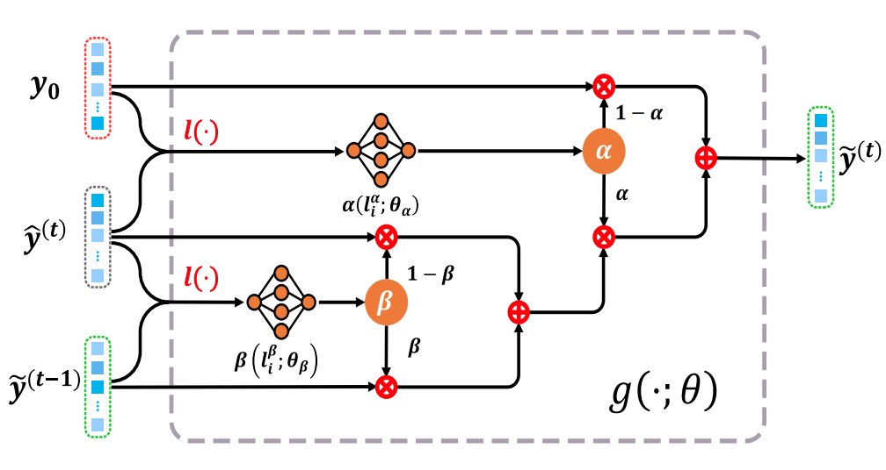
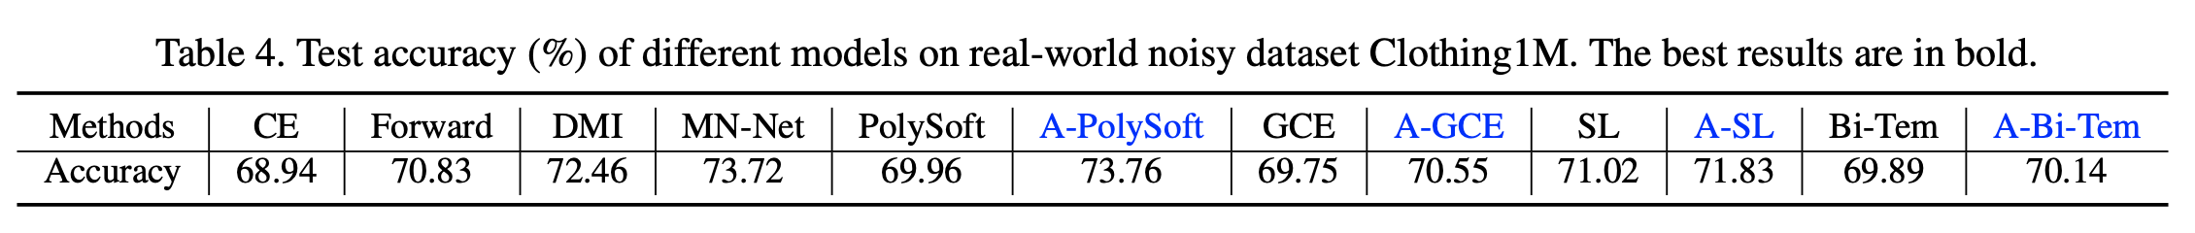
MW-Net, Adaptive loss, Soft label corrector

Slide 22
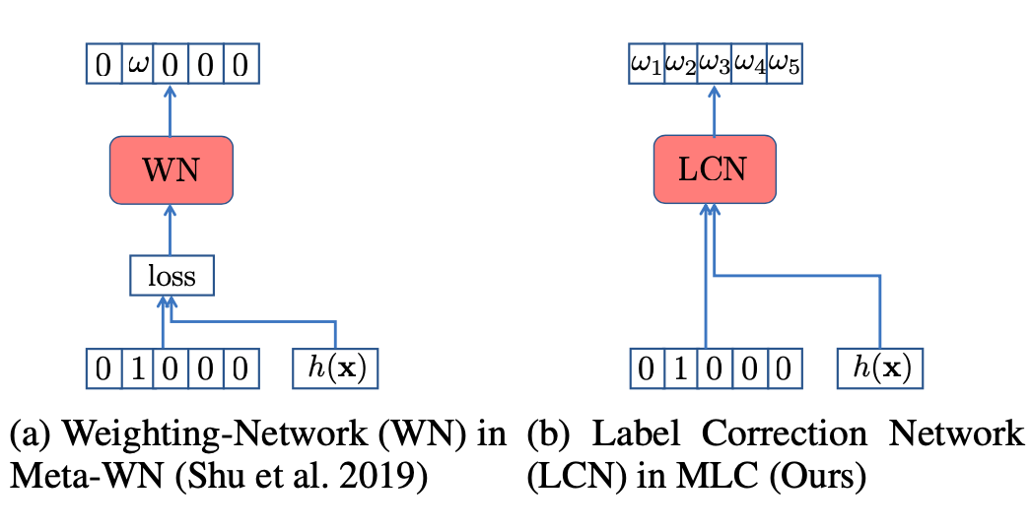
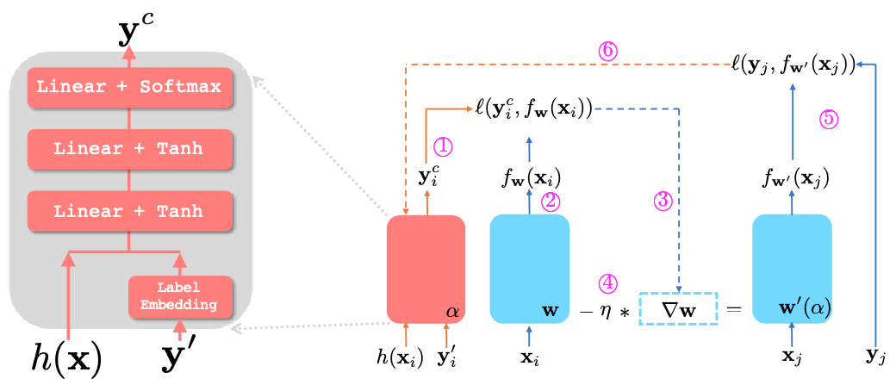
Meta Label Correction for Noisy Label Learning

Slide 23
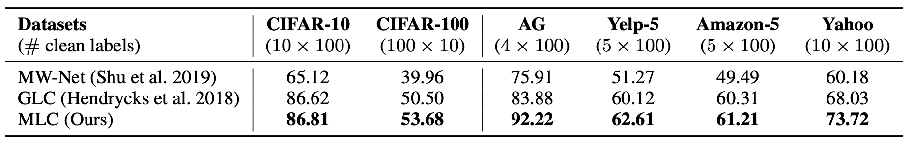
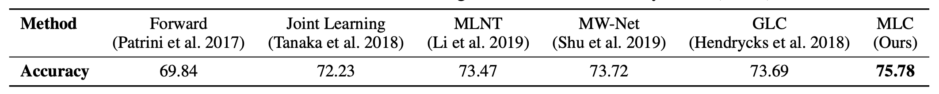
Meta Label Correction for Noisy Label Learning

Slide 24
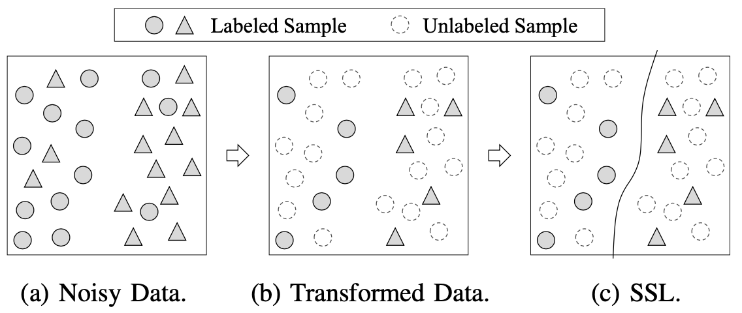
Semi-supervised Learning
To adopt SSL methods
Label aggregation
Self-ensemble
MixMatch (DivideMix)

Slide 25
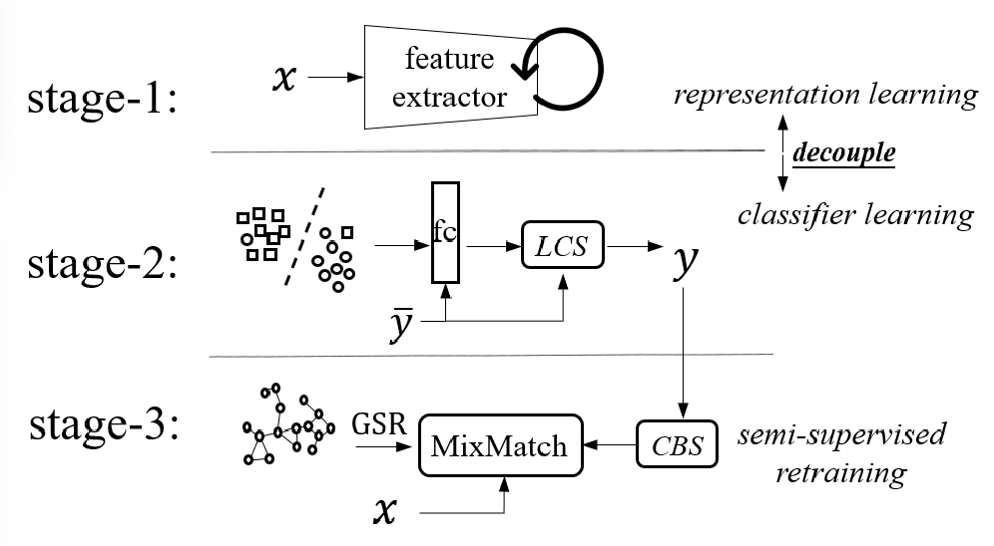
Decoupling Representation and Classifier for Noisy Label Learning

Slide 26
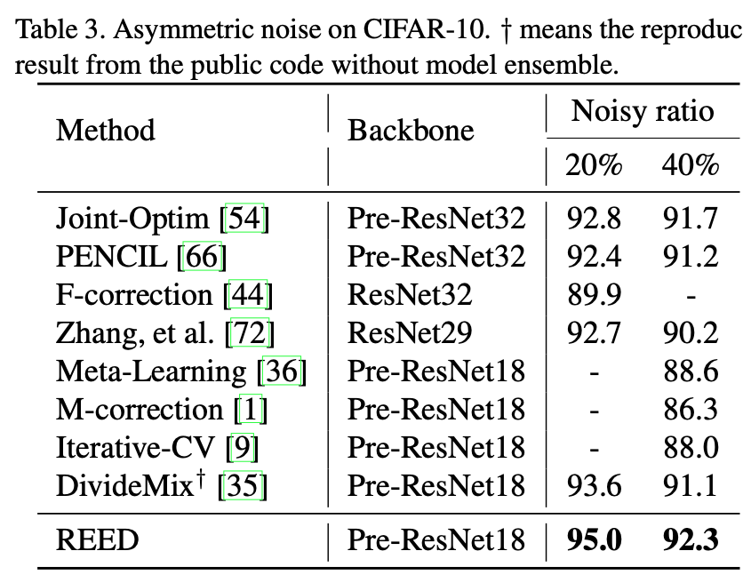
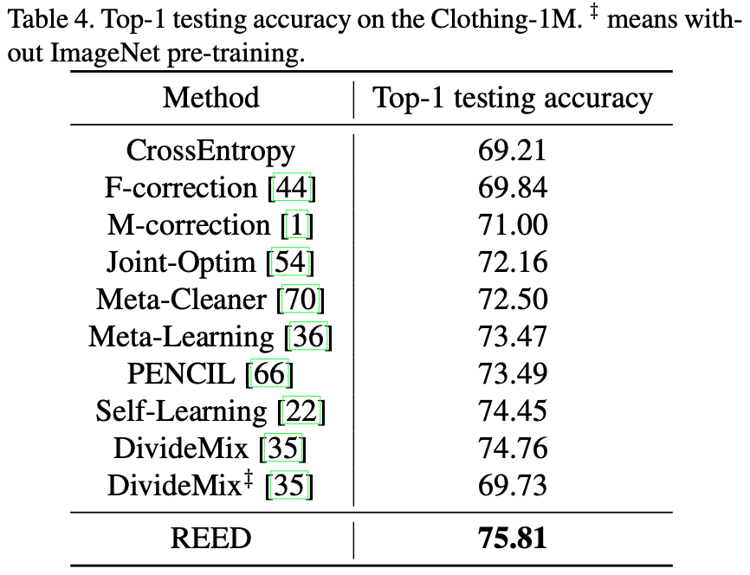
Decoupling Representation and Classifier for Noisy Label Learning

Slide 27
Comparison
(P1) Flexibility
(P2)No Pre-training
(P3) Full Exploration
(P4)No Supervision
(P5) Heavy Noise
(P6) Complex Noise

Slide 28
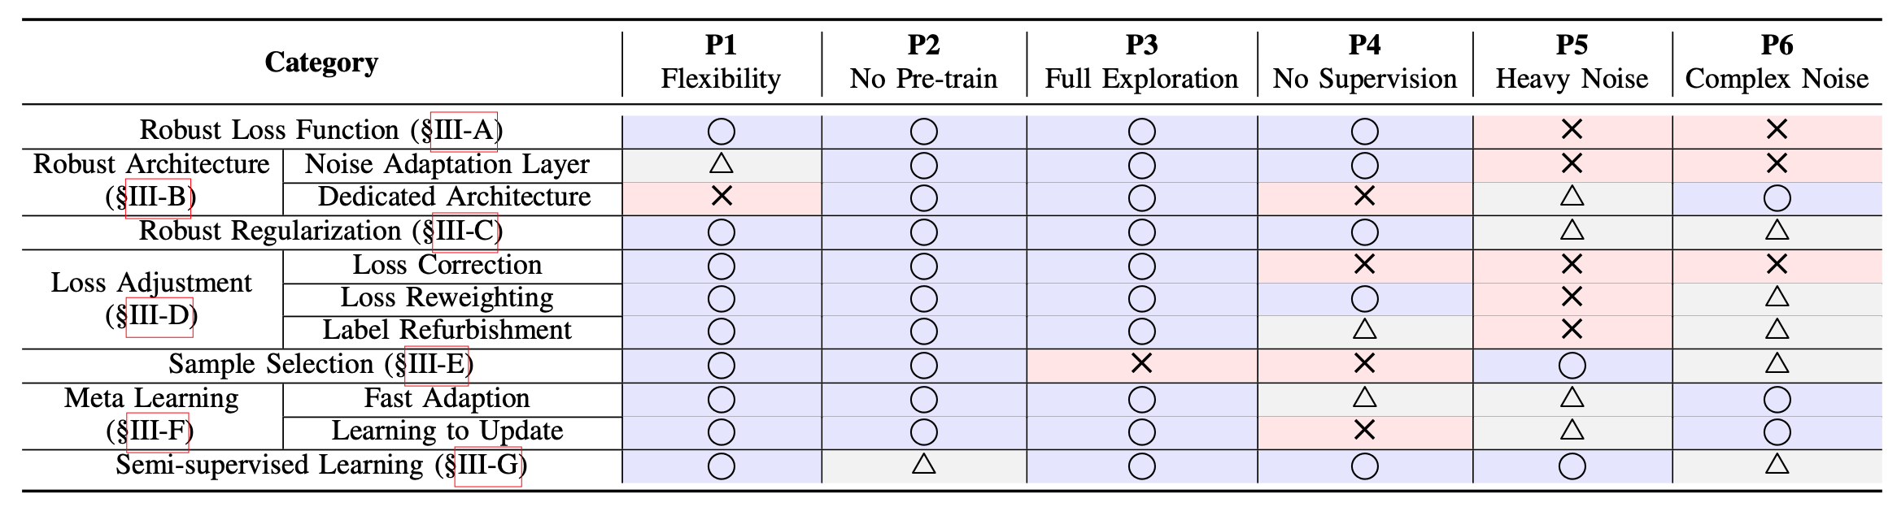
Comparison
Detailed comparison, code links for various methods, please refer to “Learning from Noisy Labels with Deep Neural: A Survey”

Slide 29
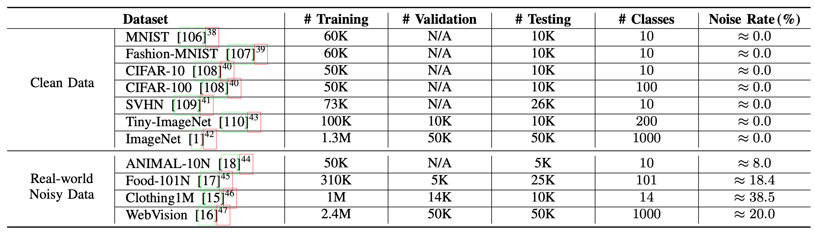
Datasets

Slide 30
Direction
Undistinguishable Sample
Complex Label Noise
Multi-label Data
Learning Efficiency

Slide 31
My further consideration
Data consistence matters
Setting with a small unbiased clean dataset may be ill-defined
Label noise problem is much more important where label is hard to obtain and data volume is limited, e.g. healthcare
Meta-learning: to treat noisy data as meta-data?
Validate with noisy data?

Slide 32
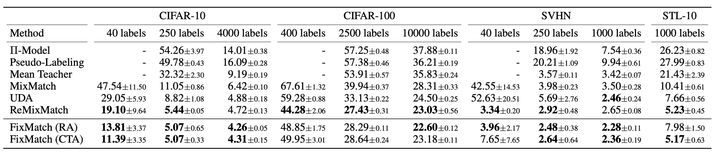
FixMatch: Simplifying Semi-Supervised Learning with Consistency and Confidence
94.93% accuracy on CIFAR-10 with 250 labels and 88.61% accuracy with 40 – just 4 labels per class.
Clean sample detection: precision > recall

Slide 33
Two papers
Sample selection with Meta-learning + FixMatch
Revision from Meta-Conv-Net
Label embedding
Meta-learning to generate indicator instead of loss (proved)
Meta-learning to tune hyper-params in FixMatch (not sure yet)
Sample selection without Meta-learning + FixMatch
Weighted loss sequence for clustering (proved)
Inter-per-class clustering (proved)
Selection ensemble based on clustering of loss seq from robust methods
Label refinement in FixMatch in case selection is not pure

